Slide 1
D E S I G N
Notes:
Design design design !!!
What is it?
Where is it?
Why do we need it?
Why do we have space in design? (the image)
How is it even related to engineering?
Let’s see
Tutor instructions:
Students shall be forming groups based on competency / skills, and each one is assigned a role – An Engineer, Manager, Artist, Designer, Producer, etc.
They are to form a WhatsApp group and add the instructor’s contact as an admin, for sharing assignment details the same day.
3. Ask them to have a notebook/markers ready. Interact with the students by asking questions to them. Make them answer relevant to design. Make them curious what are they going to see next. Motivate them till they are comfortable to interact – by language. Ensure that the brains started to think. Total time : 15 mins

Slide 2
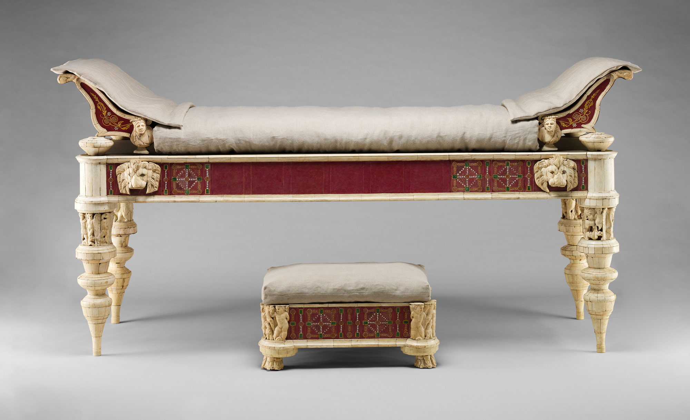
Notes:
Ask the students to observe the image. Repeat the questions. Is this a design?
If yes, then what do you consider as design in this?
Is it the shape? Or colour? Or function? What is design in this?
(tutors do not give any answers, just motivate them to think and speak out. Make them to write down the factors they consider as design)

Slide 3
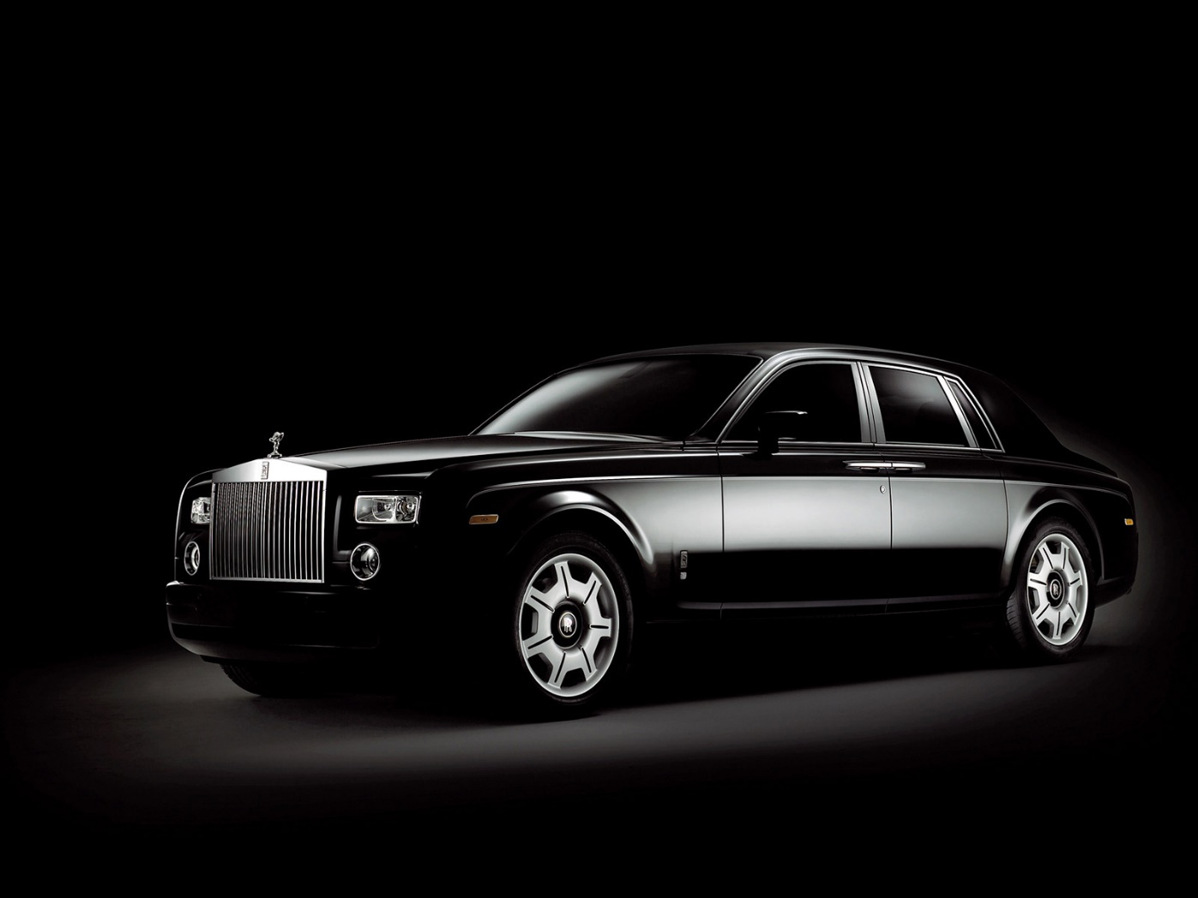
Notes:
Repeat as previous slide

Slide 4

Notes:
Repeat as previous slide

Slide 5
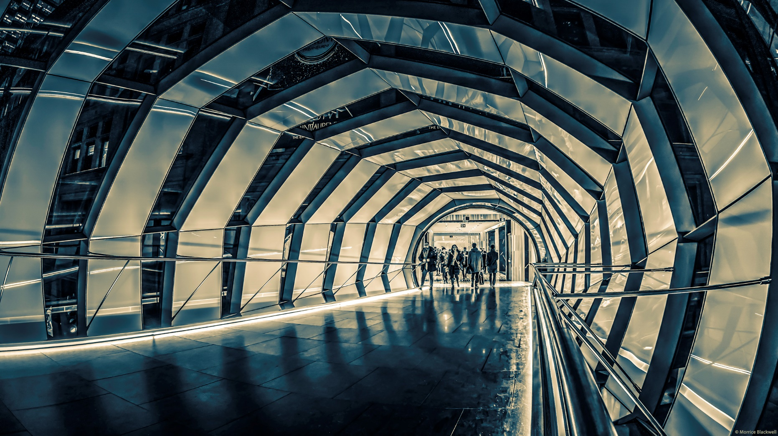
Notes:
Repeat as previous slide

Slide 6
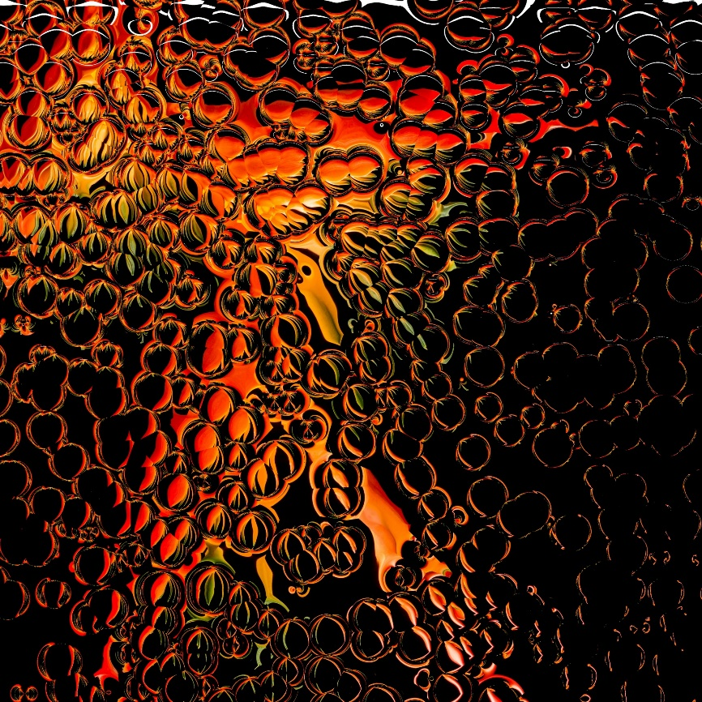
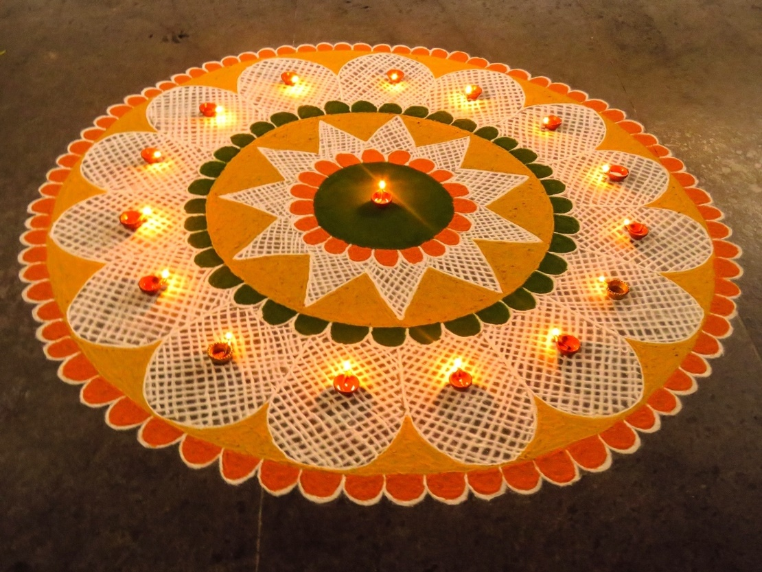
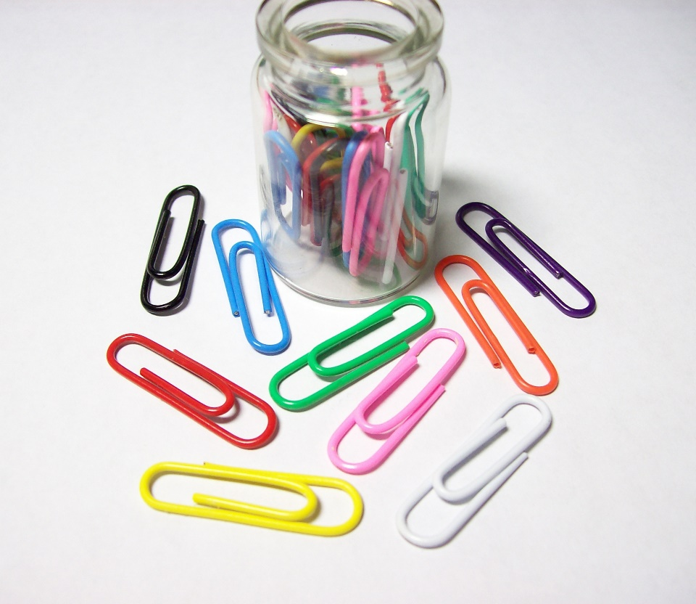
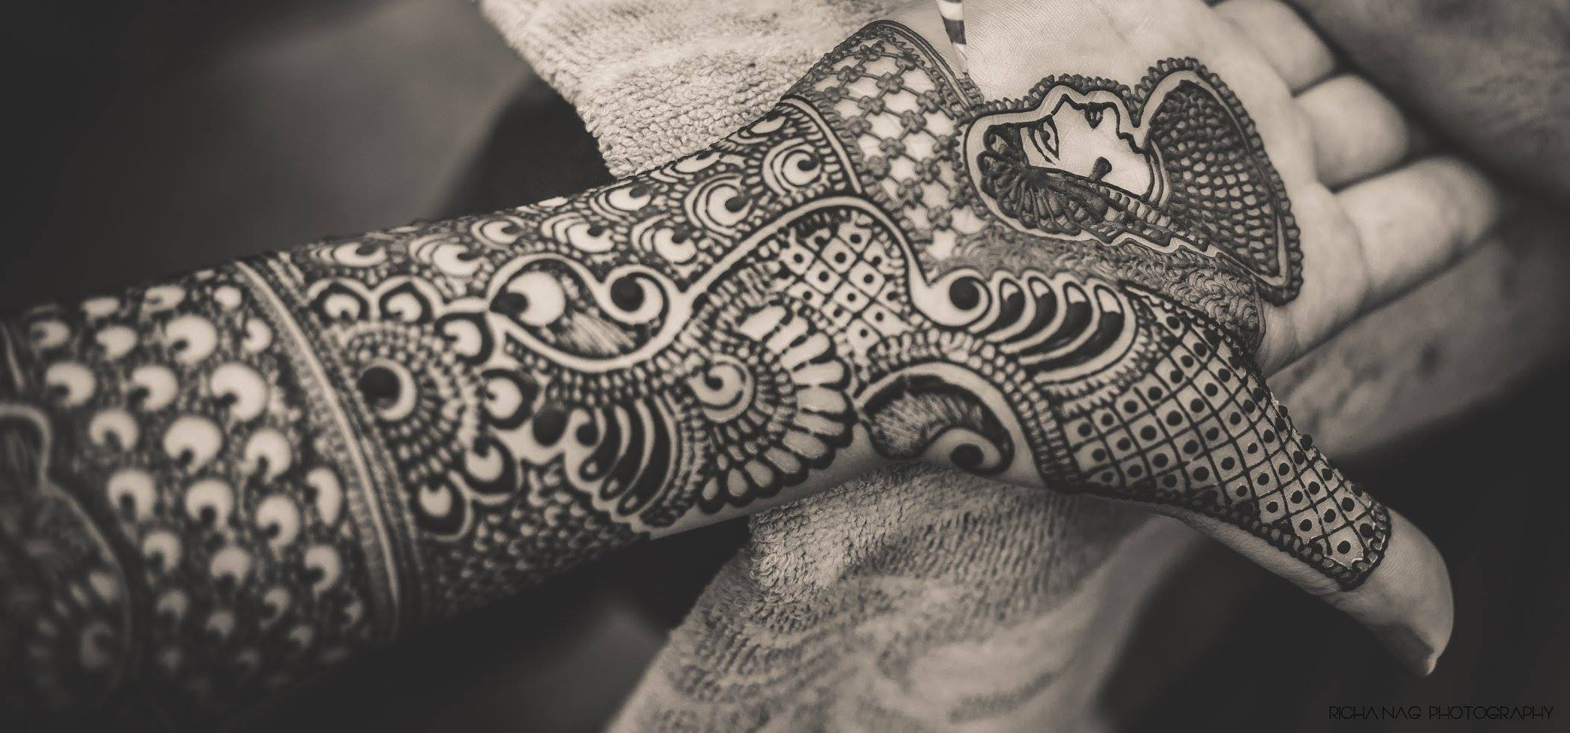
Notes:
Repeat as previous slide. Conclude your questions by asking where is design in all images. Which among the above is designed.
What is role

Slide 7
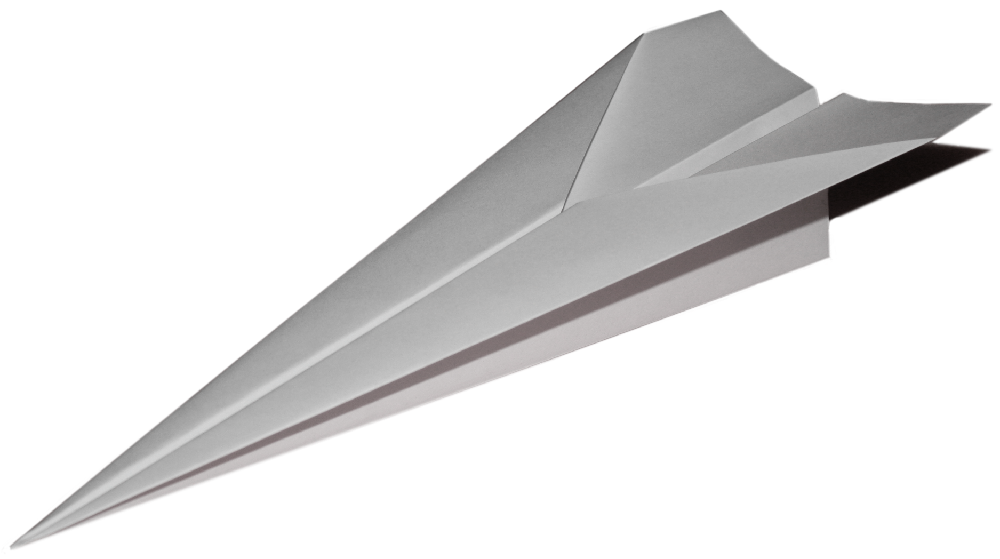
Activity 1
Notes:
Team Activity (2-3 members/team) – Build a paper plane. Conditions – Single paper, should cross more than 20 feet and Hit the target.
Shape and structure is not a constraint. Multiple Planes with different structure are preferred. Finally present the best plane.
Total time – 25 mins
Tutor instructions: At end of the activity, question the learning in this activity.
To students: Did you understand what is design now?
Is it the material? Or is it the Size? Or is the shape? Or is the colour of the plane? Or is it the way you launched it?
“Design” is the whole process followed.

Slide 8
Design process
1
2
3
4
5
Identify
Define
Ideate
Prototype
Test
Notes:
Tutor instructions: Relate this process with the previous activity done.
First step was to Identify the needs of the plane
Second, Defined what is your target, Where you wanted to hit, understood the conditions
Third, brainstormed with the team and developed ideas of planes with different shapes and structures,
Fourth, Made quick prototypes
Fifth tested the prototypes and presented the best ones
This is the same process we follow to design.
Identify the needs, Problems, challenges of the user
Define the Requirements in a consolidated manner
Develop multiple solutions
Prototype the solutions
Test them
Present the best solution
Tutors need to elaborate the same with various examples

Slide 9
Bad vs Good
DESIGN

Slide 10
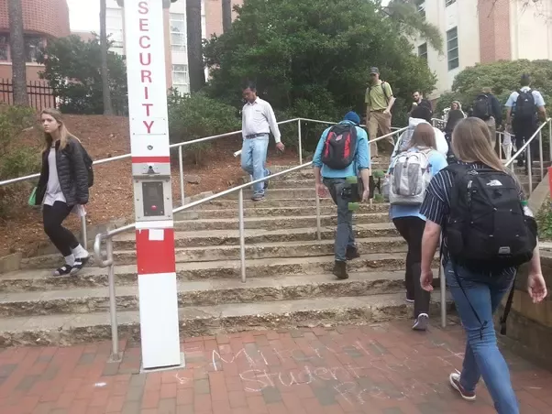
Notes:
Did you understand what is the problem in this image??

Slide 11
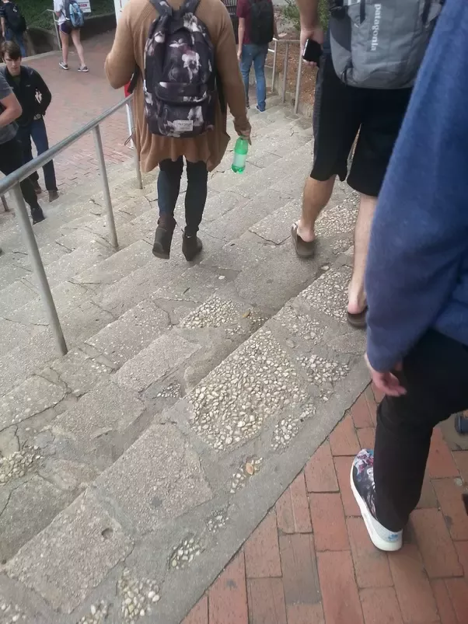
Notes:
Do you understand now?
The steps are straight whereas the hand rails are diagonally placed.
The users mentally get confused and would feel psychologically uncomfortable while walking on these.
The stairs direct them to go straight, while hand rails direct to go diagonally.

Slide 12
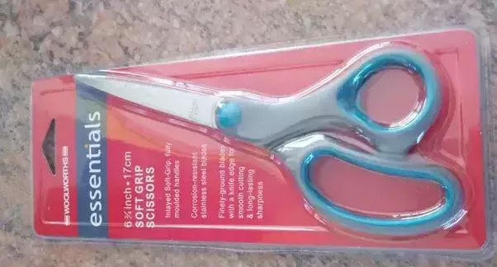
Notes:
Packaging of scissor needs a scissor to open it

Slide 13
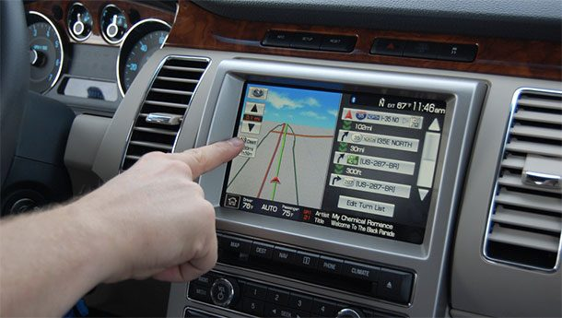
Notes:
Touch screen interface makes the user lose attention towards the road, since he is forced to look at the screen.

Slide 14
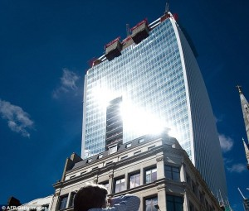
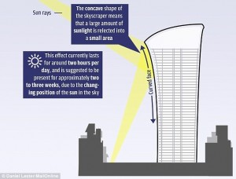
Notes:
Concave surface of the building converges the light rays to the small buildings opposite to it

Slide 15
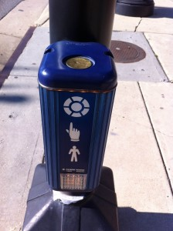
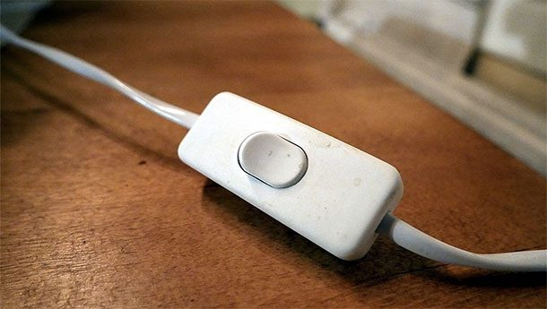
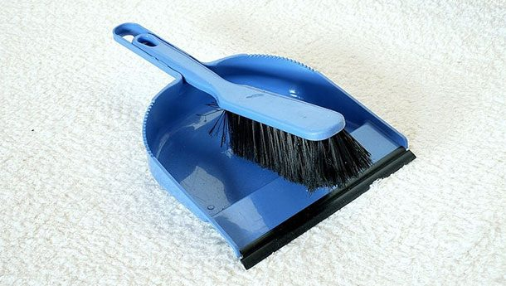

Slide 16
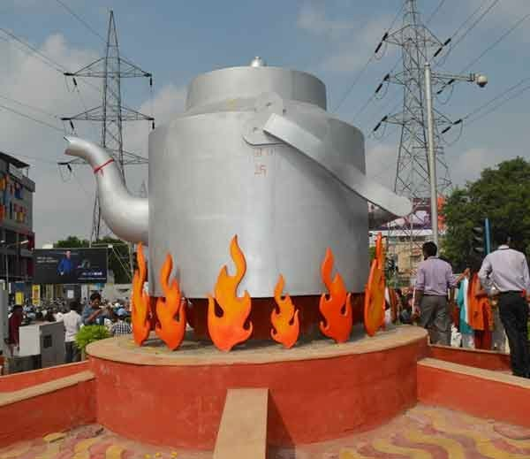
Notes:
Installation in Ahmedabad. The position of the handle axis should have been parallel to the mouth

Slide 17
Activity 2
Sketch a non-functional or non-usable product
Time: 10 mins
The product should be aesthetic but non –functional. It should be complete, form wise (eg. Watch, spectacle, pen, bag, shoe, belt etc.)
Notes:
Form is the shape of the product. Form wise denotes the look, shape and structure of the product.
By end of this activity again question the learning from this.
Make them understand how form is influenced by the function. “Form follows Function” – Is a mantra

Slide 18
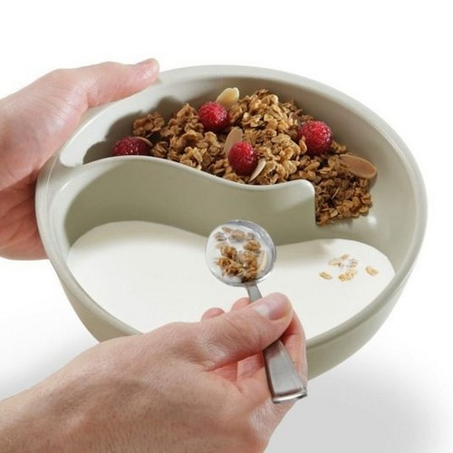
Notes:
Make the students talk extemporately about the image shown - 2 minutes.
Explain how the form is influenced by the function.

Slide 19
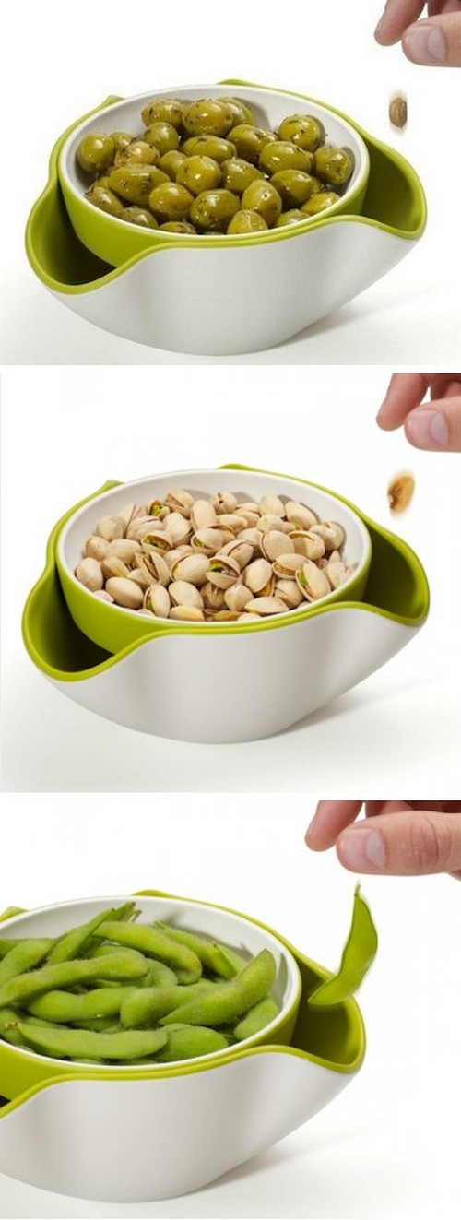
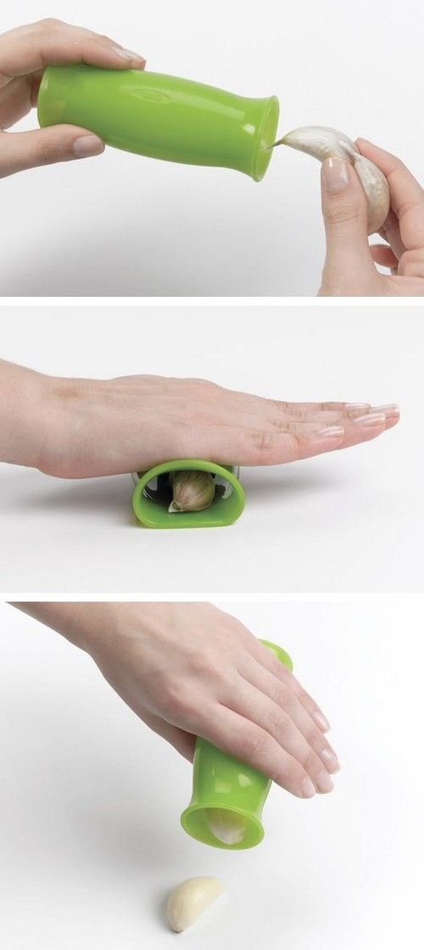
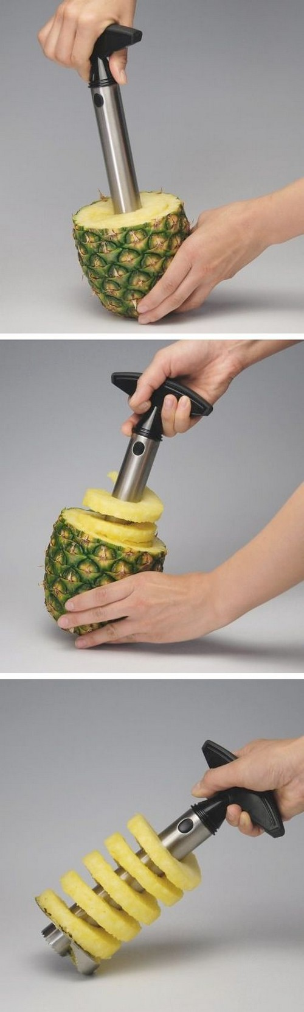
Notes:
Make the students talk extemporately about the image shown – 2 minutes.
Explain how the form is influenced by the function.

Slide 20
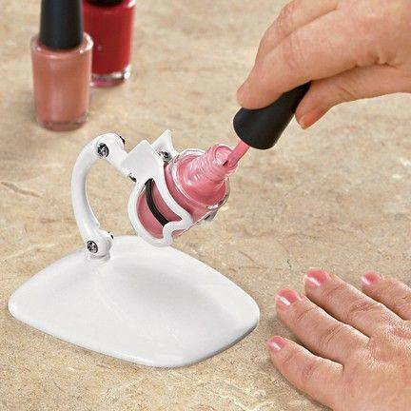

Notes:
Make the students talk extemporately about the image shown - 2 minutes.
Explain how the form is influenced by the function.

Slide 21
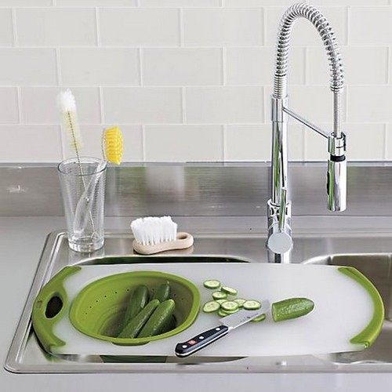
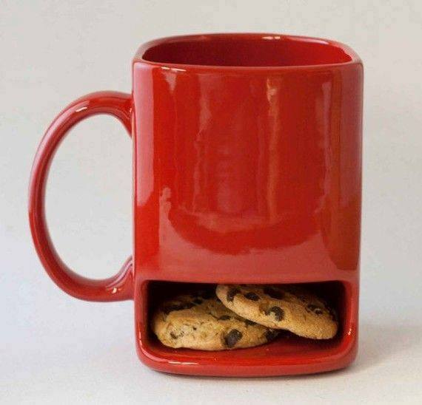
Notes:
Make the students talk extemporately about the image shown - 2 minutes.
Explain how the form is influenced by the function.

Slide 22
Review
Design understanding
Design process
Bad and Good design
Importance of form and function
Notes:
Review the activities in the class.

Slide 23
Assignment 1 Marks: 3
Identify 5 good and bad designs in your kitchen.
Justify why those designs are good / bad.
Make a Ppt in teams as per template being shared to you.
Capture photographs and give notes to each photograph – send it to the leader who compiles the Ppt by adding their work
Notes:
Share ‘PDS - Assignment - 1 - Good Design & Bad Design – Template.pptx’ to the WhatsApp Group.

